Slide 1
HTML Workshop

Slide 2
What is HTML
Hyper Text Markup Language
Not a programming language
Markup language for creating webpages / documents
Building blocks of the web

Slide 3
Creating an HTML file
Does not need a server
Files must end with the .html extension
Runs in a web browser
Index.html is the root / home page of a website

Slide 4
Hello World!

Slide 5
Tag Syntax
<tagname> content </tagname>
<h1> About Us </h1>
<p> This is a paragraph </p>
<br/>
Element names surrounded by angle brackets
Normally come in pairs (start tag & end tag)
End tag is usually the same but with a forward slash
Some tags close themselves

Slide 6
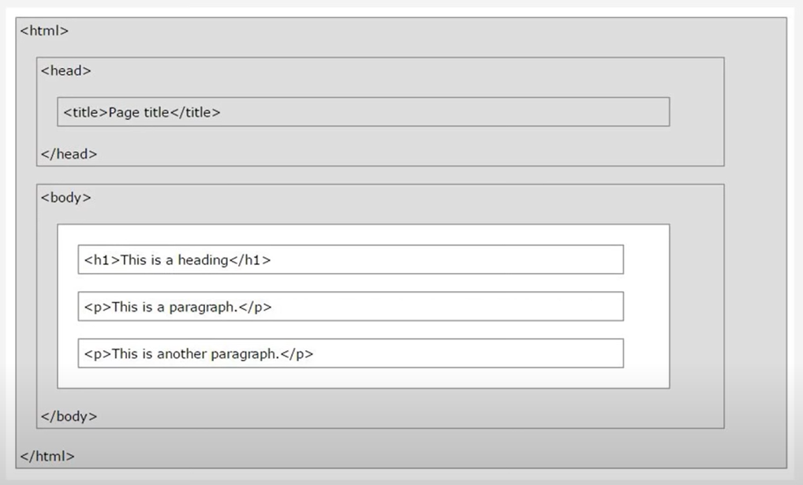
HTML Page Structure

Slide 7
Example
<!DOCTYPE HTML>
<html>
<head>
<title>Page Title</title>
</head>
<body>
<h1>My First Heading</h1>
<p>My first paragraph</p>
<body>
</html>

Slide 8
Inline vs. Block Level Element
Inline Elements
Do not start on a new line
Take only the necessary width
Block Elements
Start on a new line
Take full width available
Block Level: <div> , <h1> - <h6>, <p>, <form>
Inline Level: <span>, <img> , <a>

Slide 9
Tag Attributes
<tagName
attributeName=“attributeValue> content </tagName>
<a href=“…”>link</a>
All tags can have attributes
Provide information about an element
Placed within the start tag
Key/Value pairs

Slide 10

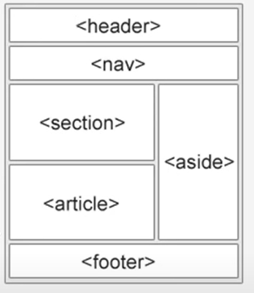
HTML 5 Semantic Tags
<header></header>
<footer></footer>
<aside></aside>
<main></main>
<article></article>
<nav></nav>
<section></section>
<details></details>

